Slide 1


AI mentoring workshop
Feb 2022

Slide 2
Examples of AI
2
Notes:
2

Slide 3
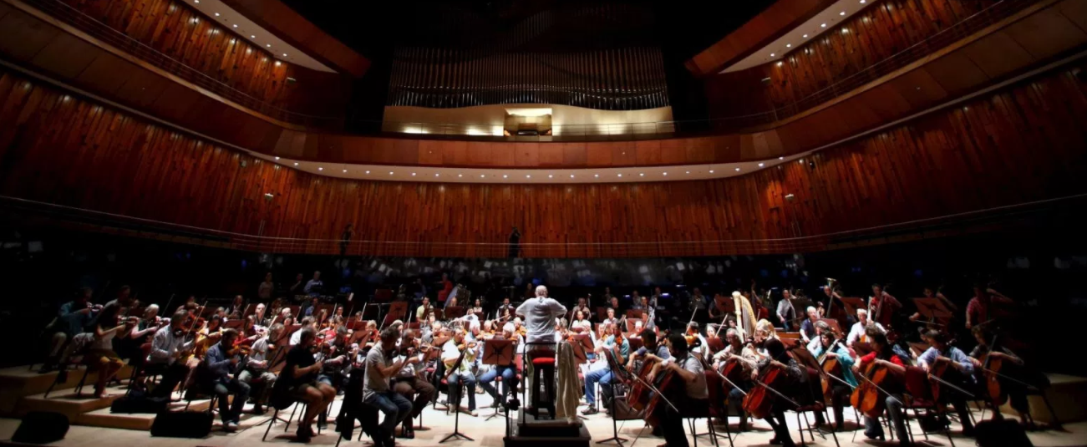
People are confusing computer-generated music with the works of J.S. Bach
LINK: https://qz.com/488701/humans-are-confusing-music-composed-by-a-computer-for-j-s-bach/
WRITTEN BY Mike Murphy
August 26, 2015
There's an app for that. (Reuters/Marcos Brindicci)
The robot revolution has come to classical music composition.
3
Notes:
3

Slide 4
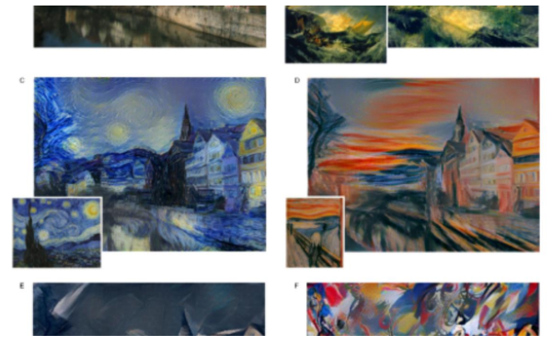
Artificial Intelligence Can Now Paint Like Art's Greatest Masters
LINK: https://motherboard.vice.com/en_us/article/wnjve5/artificial-intelligence-can-now-paint-like-arts-greatest-masters
Jason Koebler
Sep 2 2015, 7:00pm
Image: Leon Gatys
4
Notes:
4

Slide 5

This program can mimic your handwriting with shocking accuracy—what could go wrong?
LINK: https://www.dailydot.com/layer8/handwriting-algorithm-privacy-security/
Ben Dickson— Aug 31, 2016 at 4:00PM
Illustration by Max Fleishman
You’ve been warned to be wary of pictures and comments you post on the internet. You might soon want to safeguard your handwritten notes as well.
5
Notes:
5

Slide 6
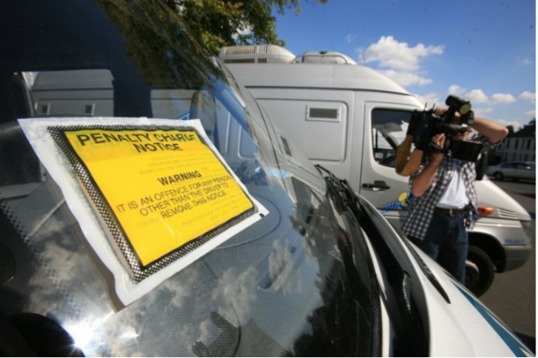
This chat bot has overturned 160,000 parking tickets in under two years - for free
LINK: http://www.ibtimes.co.uk/how-appeal-parking-ticket-this-ai-robot-lawyer-will-fight-fines-you-free-1567908
By James Billington
Updated June 28, 2016 21:16 BST
Got a parking ticket? The DoNotPay chat bot uses AI to help the public appeal fines and it's impressively successful. Getty
6
Notes:
6

Slide 7
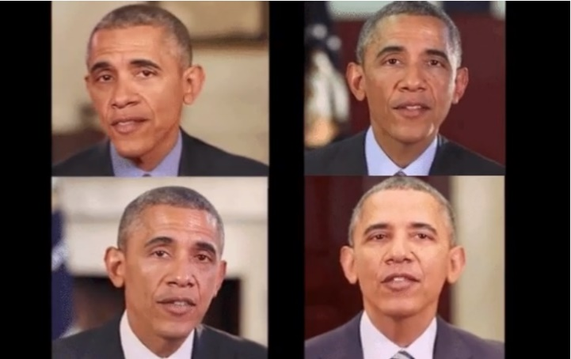
New AI research makes it easier to create fake footage of someone speaking
LINK: https://www.theverge.com/2017/7/12/15957844/ai-fake-video-audio-speech-obama
By James Vincent
@jjvincent Jul 12, 2017, 2:21pm EDT
7
Notes:
7

Slide 8
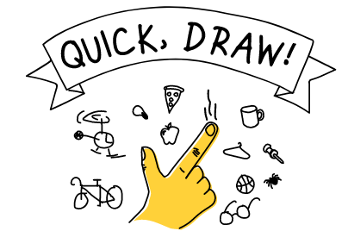
Can a neural network learn to recognize doodling?
LINK: https://quickdraw.withgoogle.com/
Can a neural network learn to recognize doodling?
Help teach it by adding your drawings to the world’s largest doodling data set, shared publicly to help with machine learning research
8
Notes:
8

Slide 9
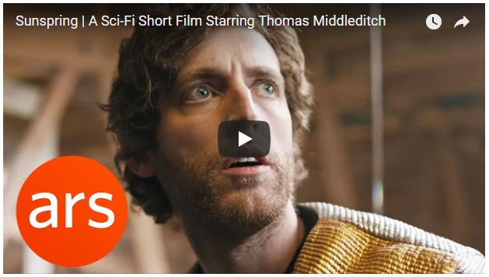
This is what happens when an AI-written screenplay is made into a film
LINK: https://www.theguardian.com/technology/2016/jun/10/artificial-intelligence-screenplay-sunspring-silicon-valley-thomas-middleditch-ai
HAL 90210
Fri 10 Jun 2016 12.47 BST Last modified on Tue 21 Feb 2017 17.23 GMT
Sunspring – a short science fiction film written by artificial intelligence
9
Notes:
9

Slide 10
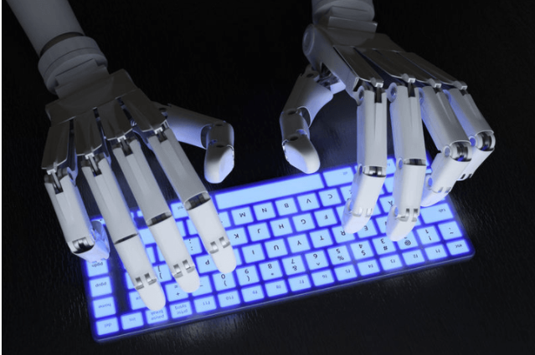
A Japanese AI program just wrote a short novel, and it almost won a literary prize
LINK: https://www.digitaltrends.com/cool-tech/japanese-ai-writes-novel-passes-first-round-nationanl-literary-prize/
By Chloe Olewitz — Posted on March 23, 2016 4:52 pm
Sergey Soldatov/123RF.com
10
Notes:
10

Slide 11
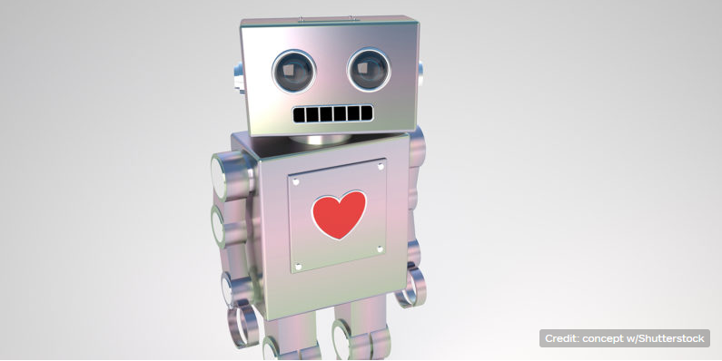
This AI can predict how long your relationship will last
LINK: https://thenextweb.com/artificial-intelligence/2017/09/29/this-ai-can-predict-how-long-your-relationship-will-last/
by RACHEL KASER — 4 months ago in ARTIFICIAL INTELLIGENCE
Unless you’re watching Her, you don’t generally connect AI with romantic angst. But researchers from the University of Southern California have trained one to give troubled relationships a death date — which might be the key to saving them.
11
Notes:
11

Slide 12
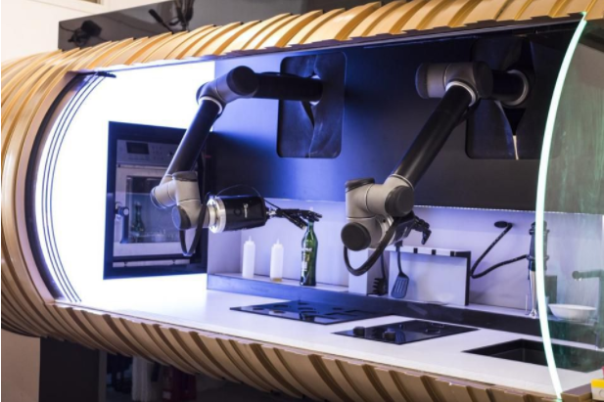
The World's First Home Robotic Chef Can Cook Over 100 Meals
12
Notes:
12

Slide 13
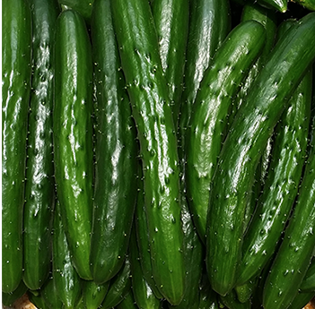
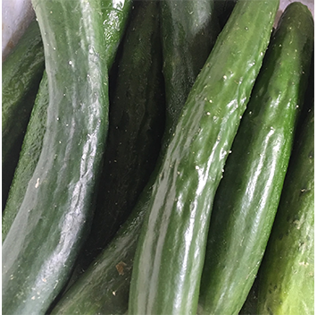
How a Japanese cucumber farmer is using deep learning and TensorFlow
Cucumbers from Makoto's farm and ones from retail stores
13
Notes:
13

Slide 14
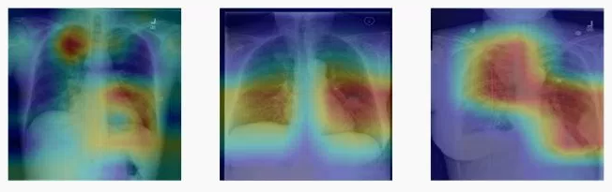
Stanford trained AI to diagnose pneumonia better than a radiologist in just two months
LINK: https://qz.com/1130687/stanford-trained-ai-to-diagnose-pneumonia-better-than-a-radiologist-in-just-two-months/
14
Notes:
14

Slide 15
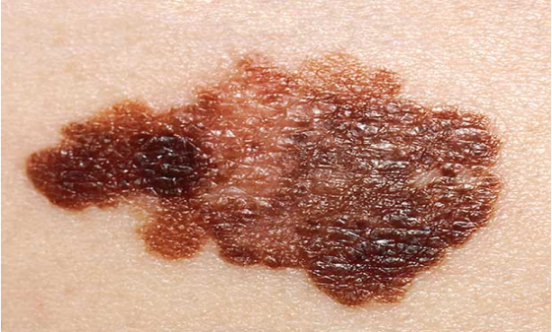
Computer Diagnoses Skin Cancers
LINK:https://spectrum.ieee.org/the-human os/biomedical/diagnostics/computer-diagnoses-skin-cancers
25 Jan 2017 | 18:00 GMT
By Emily Waltz
Photo: National Institutes of Health/Getty Images
Deep learning algorithm identifies skin cancers as accurately as dermatologists
Researchers have developed an algorithm that recognizes skin cancer in photos about as well as dermatologists do. So says a study published today in Nature. The algorithm, developed by a group at Stanford University, is not the first automated system for recognizing skin lesions, but it’s likely the most robust, the researchers say.
15
Notes:
15

Slide 16

Ophthalmologists vs. AI: It's a Tie
LINK: https://spectrum.ieee.org/the-human-os/biomedical/diagnostics/ophthalmologists-vs-ai-its-a-tie
1 Feb 2017 | 15:00 GMT
By Megan Scudellari
Photo: Heydt/VWPics/AP Photo
16
Notes:
16

Slide 17
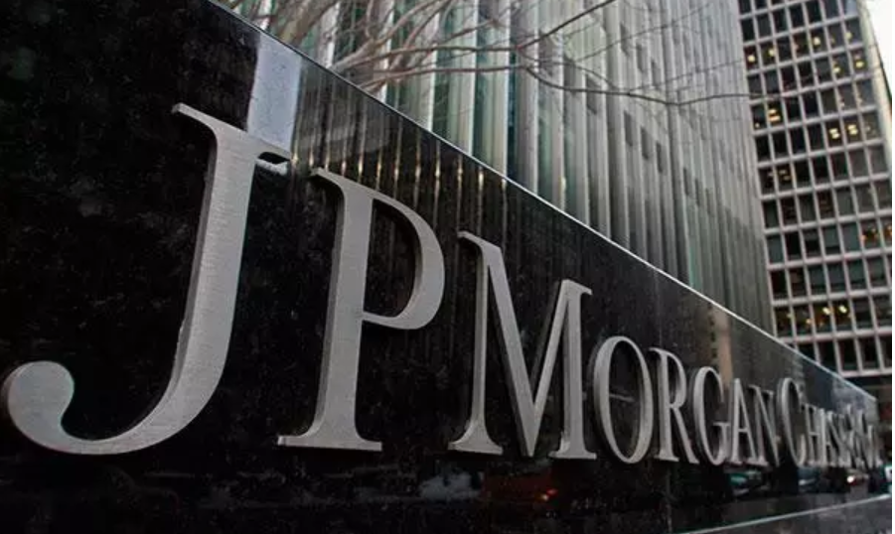
JPMorgan software does in seconds what took lawyers 360,000 hours
LINK: https://www.independent.co.uk/news/business/news/jp-morgan-software-lawyers-coin-contract-intelligence-parsing-financial-deals-seconds-legal-working-a7603256.html
Hugh Son Tuesday 28 February 2017 10:51 GMT
A new era of automation is now in overdrive as cheap computing power converges with fears of losing customers to startups
17
Notes:
17

Slide 18
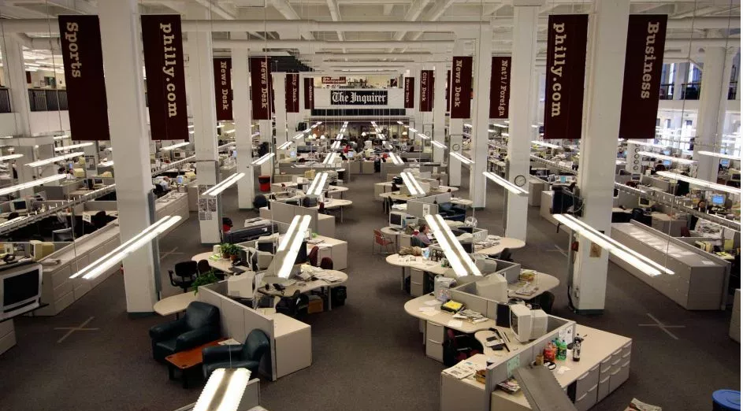
The AP’s newest business reporter is an algorithm
LINK: https://qz.com/228218/the-aps-newest-business-reporter-is-an-algorithm/
WRITTEN BY Nikhil Sonnad
June 30, 2014
How to upset a newsroom. (AP Photo/Joseph Kaczmarek)
18
Notes:
18

Slide 19
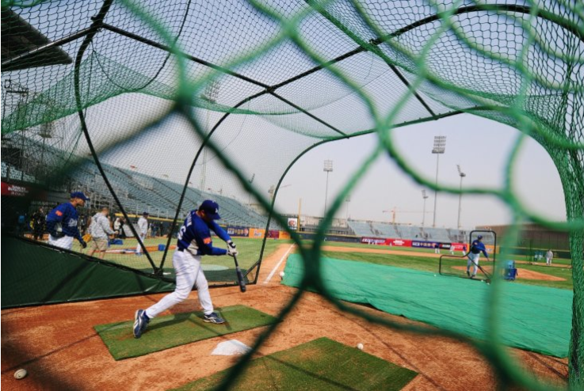
Associated Press to expand its sports coverage by using AI to write Minor League Baseball articles
LINK: http://www.ibtimes.co.uk/associated-press-expand-its-sports-coverage-by-using-ai-write-minor-league-baseball-articles-1568804
By Hyacinth Mascarenhas
Updated July 6, 2016 08:42 BST
The Associated Press is expanding its sports coverage by using AI to write Minor League Baseball stories Frederic J Brown/AFP/Getty Images
19
Notes:
19

Slide 20
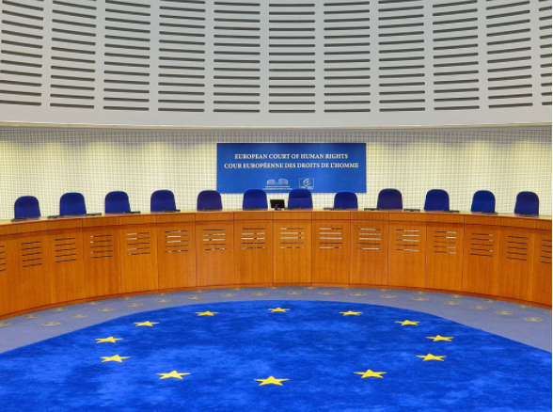
AI predicts outcomes of human rights trials
LINK: https://www.ucl.ac.uk/news/news-articles/1016/241016-AI-predicts-outcomes-human-rights-trials
24 October 2016
The judicial decisions of the European Court of Human Rights (ECtHR) have been predicted to 79% accuracy using an artificial intelligence (AI) method developed by researchers at UCL, the University of Sheffield and the University of Pennsylvania.
20
Notes:
20

Slide 21
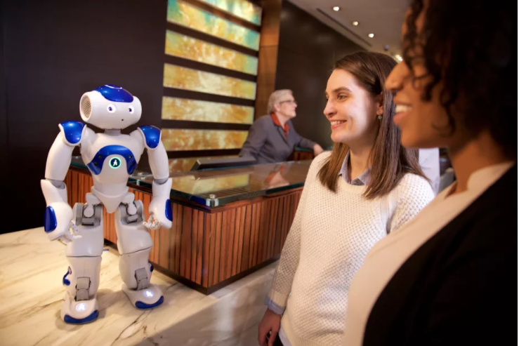
Hilton and IBM built a Watson-powered concierge robot
LINK: https://www.theverge.com/2016/3/9/11180418/hilton-ibm-connie-robot-watson-hotel-concierge
By Nick Statt @nickstatt Mar 9, 2016
Hilton/IBM
21
Notes:
21

Slide 22
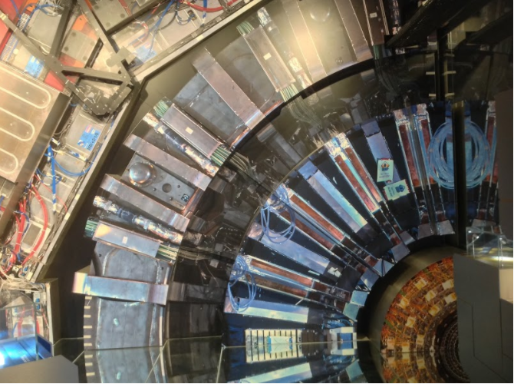
Large Hadron Collider. Image Credit: Vieamusante / Wikimedia
Of course, continuing research in this field wouldn’t move forward at all without the physicists themselves, challenging and exploring our understanding of the natural world. But AI is becoming an ever-increasingly useful tool. For example, the Large Hadron Collider (LHC), the largest particle accelerator in the world, smashes together protons in an attempt to discover new particles and more fully comprehend the universe. But, with so many collisions — approximately 600 million per second — the amount of data created by the LHC are immense.
22
Notes:
22

Slide 23
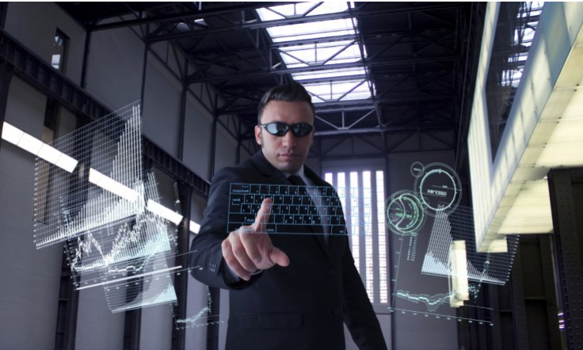
CIA using deep learning neural networks to predict social unrest five days before it happens
LINK: http://www.ibtimes.co.uk/cia-using-deep-learning-neural-networks-predict-social-unrest-five-days-before-it-happens-1585115
By Mary-Ann Russon
October 6, 2016 12:29 BST
The CIA is now using artificial intelligence to help predict when critical situations of social instability are likely to occur iStock
23
Notes:
23

Slide 24
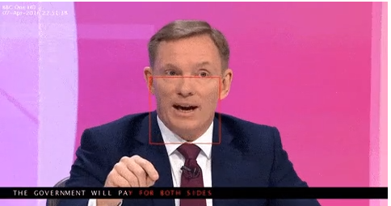
Speech & language
AI Has Beaten Humans at Lip-reading
LINK: https://www.technologyreview.com/s/602949/ai-has-beaten-humans-at-lip-reading/
by Jamie Condliffe November 21, 2016
A pair of new studies show that a machine can understand what you’re saying without hearing a sound.
Lip-reading is notoriously difficult, depending as much on context and knowledge of language as it does on visual clues. But researchers are showing that machine learning can be used to discern speech from silent video clips more effectively than professional lip-readers can.
24
Notes:
24

Slide 25
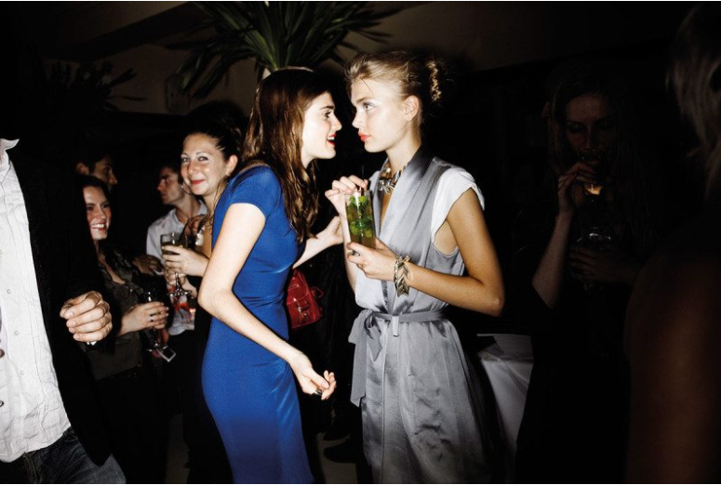
An AI has learned how to pick a single voice out of a crowd
LINK: https://www.newscientist.com/article/2151268-an-ai-has-learned-how-to-pick-a-single-voice-out-of-a-crowd/
NEWS & TECHNOLOGY 24 October 2017
By Richard Gray
Voiceprints can help make sense of what people in a crowd say
Christopher Anderson/Magnum Photos
Devices like Amazon’s Echo and Google Home can usually deal with requests from a lone person, but like us they struggle in situations such as a noisy cocktail party, where several people are speaking at once.
25
Notes:
25

Slide 26
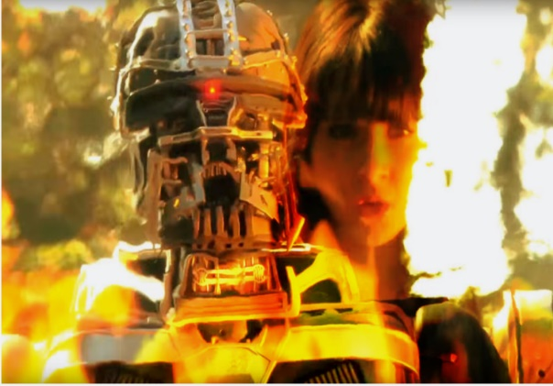
The AI that (almost) lets you speak to the dead
LINK: https://arstechnica.com/information-technology/2016/07/luka-ai-chatbot-speaking-to-the-dead-mind-uploading/
BOB DORMON - 7/6/2016, 2:15 PM
Very recently however, Luka was adapted in a brand new way, to include a chatbot based on a real human being—one who just so happens to be dead. It’s this ghost-in-the-machine that has the audience spellbound, as Luka's cofounder Eugenia Kuyda explains how text messages, social media conversations, and other sources of information on the deceased were grafted onto an existing AI platform. It started out as an experiment that, in a matter of months, enabled her and others to continue to interact with Roman Mazurenko, a fellow Russian who had died in a road traffic accident in November last year, the man she describes as her soul mate.
26
Notes:
26

Slide 27
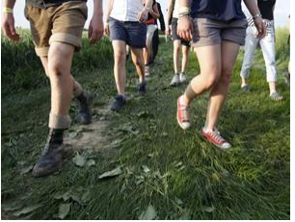
Transport
Vision
Cameras know you by your walk
LINK: https://www.newscientist.com/article/mg21528835-600-cameras-know-you-by-your-walk/
By Jim Giles
19 September 2012
Improvements in gait analysis mean your characteristic way of walking could soon be used to identify you – wherever you are
27
Notes:
27

Slide 28
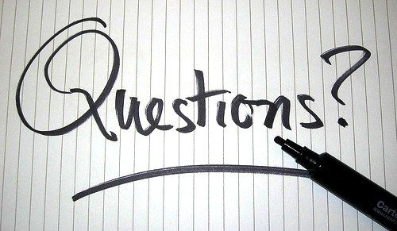
OMPEG Masterclass
Questions including technical questions are ok
28
Notes:
28

Slide 29
An executive’s
guide to AI
(adapted from Mckinsey)
29
Notes:
29

Slide 30
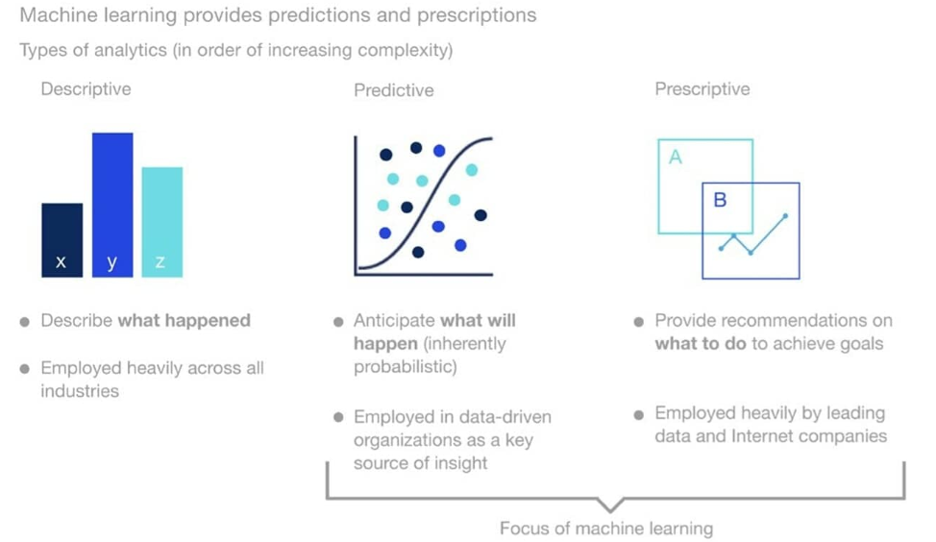
30
Notes:
30

Slide 31
Supervised learning
What is it
An algorithm uses training data and feedback from humans to learn the relationship of given inputs to a given output (eg, how the inputs “time of year” and “interest rates” predict housing prices)
31
Notes:
31

Slide 32
Supervised learning
When to use it
You know how to classify the input data and the type of behavior you want to predict, but you need the algorithm to calculate it for you on new data
32
Notes:
32

Slide 33
Supervised learning
How it works
1. A human labels every element of the input data (eg, in the case of predicting housing prices, labels the input data as “time of year,” “interest rates,” etc) and defines the output variable (eg, housing prices)
2. The algorithm is trained on the data to find the connection between the input variables and the output
3. Once training is complete— typically when the algorithm is sufficiently accurate—the algorithm is applied to new data
33
Notes:
33

Slide 34
Unsupervised learning
What is it
An algorithm explores input data without being given
an explicit output variable (eg, explores customer demographic data to identify patterns)
34
Notes:
34

Slide 35
Unsupervised learning
When to use it
You do not know how to classify the data, and you want the algorithm to find patterns and classify the data for you
35
Notes:
35

Slide 36
Unsupervised learning
How it works
1. The algorithm receives unlabeled data (eg, a
set of data describing customer journeys on a website)
2. It infers a structure from the data
3. The algorithm identifies groups of data that exhibit similar behavior (eg, forms clusters of customers that exhibit similar buying behaviors)
36
Notes:
36

Slide 37
Reinforcement learning
What is it
An algorithm learns to perform a task simply by trying to
maximize rewards it receives for its actions (eg, maximizes points it receives for increasing returns of an investment portfolio)
37
Notes:
37

Slide 38
Reinforcement learning
When to use it
You don’t have a lot of training data; you cannot clearly define the ideal end state; or the only way to learn about the environment is to interact with it
38
Notes:
38

Slide 39
Reinforcement learning
How it works
1. The algorithm takes an action on the environment (eg, makes a trade in a financial portfolio)
2. It receives a reward if the action brings the machine
a step closer to maximizing the total rewards available (eg, the highest total return on the portfolio)
3. The algorithm optimizes for the best series of actions by correcting itself over time
39
Notes:
39

Slide 40
Supervised learning:
Algorithms and
sample business use
cases
40
Notes:
40

Slide 41
Linear regression
Highly interpretable, standard method for modeling the past relationship between independent input variables and dependent output variables (which can have an infinite number of values) to help predict future values of the output variables
Understand product-sales drivers such as competition prices, distribution, advertisement, etc
Optimize price points and estimate product-price elasticities
41
Notes:
41

Slide 42
Logistic regression
Extension of linear regression that’s used for classifation tasks, meaning the output variable is binary (eg, only black or white) rather than continuous (eg, an infinite list of potential colors)
Ref https://machinelearningmastery.com/classification-versus-regression-in-machine-learning/
Classify customers based on how likely they are to repay a loan
Predict if a skin lesion is benign or malignant based on its characteristics (size, shape, color, etc)
42
Notes:
42

Slide 43
Linear/quadratic discriminant analysis
Upgrades a logistic regression to deal with nonlinear problems—those in which changes to the value of input variables do not result in proportional changes to the output variables.
Predict client churn
Predict a sales lead’s likelihood of closing
43
Notes:
43

Slide 44
Decision tree
Highly interpretable classification or regression model that splits data-feature values into branches at decision nodes (eg, if a feature is a color, each possible color becomes a new branch) until a final decision output is made
Provide a decision framework for hiring new employees
Understand product attributes that make a product most likely to be purchased
44
Notes:
44

Slide 45
Naive Bayes
Classification technique that applies Bayes theorem, which allows the probability of an event to be calculated based on knowledge of factors that might affect that event (eg, if an email contains the
word “money,” then the probability of it being spam
is high)
Analyze sentiment to assess product perception in the market
Create classifiers to filter spam emails
45
Notes:
45

Slide 46
Support vector machine
A technique that’s typically used for classification but can be transformed to perform regression. It draws an optimal division between classes (as wide as possible). It also can be quickly generalized to solve nonlinear problems
Predict how many patients a hospital will need to serve in a time period
Predict how likely someone is to click on an online ad
46
Notes:
46

Slide 47
Random forest
Classification or regression model that improves the accuracy of a simple decision tree by generating multiple decision trees and taking a majority vote of them to predict the output, which is a continuous variable (eg, age) for a regression problem and a discrete variable (eg, either black, white, or red) for classification
Predict call volume in call centers for staffing decisions
Predict power usage in an electrical- distribution grid
47
Notes:
47

Slide 48
AdaBoost
Classification or regression technique that uses a multitude of models to come up with a decision but weighs them based on their accuracy in predicting the outcome
Detect fraudulent activity in credit-card transactions. Achieves lower accuracy than deep learning
Simple, low-cost way to classify images (eg, recognize land usage from satellite images for climate-change models). Achieves lower accuracy than deep learning
48
Notes:
48

Slide 49
Gradient-boosting trees
Classification or regression technique that generates decision trees sequentially, where each tree focuses on correcting the errors coming from the previous tree model. The final output is a combination of the results from all trees
Forecast product demand and inventory levels
Predict the price of cars based on their characteristics (eg, age and mileage)
49
Notes:
49

Slide 50
Simple neural network
Model in which artificial neurons (software- based calculators) make up three layers (an input layer, a hidden layer where calculations take place, and an output layer) that can be used to classify data or find the relationship between variables in regression problems
Predict the probability that a patient joins a healthcare program
Predict whether registered users will be willing or not to pay a particular price for a product
50
Notes:
50

Slide 51
Unsupervised learning:
Algorithms and sample
business use
cases
51
Notes:
51

Slide 52
K-means clustering
Puts data into a number of groups (k) that each contain data with similar characteristics (as determined by the model, not in advance by humans)
Segment customers into groups by distinct charateristics (eg, age group)— for instance, to better assign marketing campaigns or prevent churn
52
Notes:
52

Slide 53
Gaussian mixture model
A generalization of k-means clustering that provides more flexibility in the size and shape of groups (clusters)
Segment customers to better assign marketing campaigns using less-distinct customer characteristics (eg, product preferences)
Segment employees based on likelihood of attrition
53
Notes:
53

Slide 54
Hierarchical clustering
Splits or aggregates clusters along a hierarchical tree to form a classification system
Cluster loyalty-card customers into progressively more microsegmented groups
Inform product usage/development by grouping customers mentioning keywords in social-media data
54
Notes:
54

Slide 55
Recommender system
Often uses cluster behavior prediction to identify the important data necessary for making a recommendation
Recommend what movies consumers should view based on preferences of other customers with similar attributes
Recommend news articles a reader might want to read based on the article she or he is reading
55
Notes:
55

Slide 56
Reinforcement learning:
Sample business use
cases
56
Notes:
56

Slide 57
Optimize the trading strategy for an options-trading portfolio
Balance the load of electricity grids in varying demand cycles
Stock and pick inventory using robots
Optimize the driving behavior of self-driving cars
Optimize pricing in real time for an online auction of a product with limited supply
57
Notes:
57

Slide 58
Deep learning:
A definition
58
Notes:
58

Slide 59
Deep learning is a type of machine learning that can process a wider range of data resources, requires less data preprocessing by humans, and can often produce more accurate results than traditional machine-learning approaches. In deep learning, interconnected layers of software-based calculators known as “neurons” form a neural network.
59
Notes:
59

Slide 60
The network can ingest vast amounts of input data and process them through multiple layers that learn increasingly complex features of the data at each layer. The network can then make a determination about the data, learn if its determination is correct, and use what it has learned to make determinations about new data. For example, once it learns what an object looks like, it can recognize the object in a new image.
60
Notes:
60

Slide 61
Understanding the major
deep learning models
and their business use
cases
61
Notes:
61

Slide 62
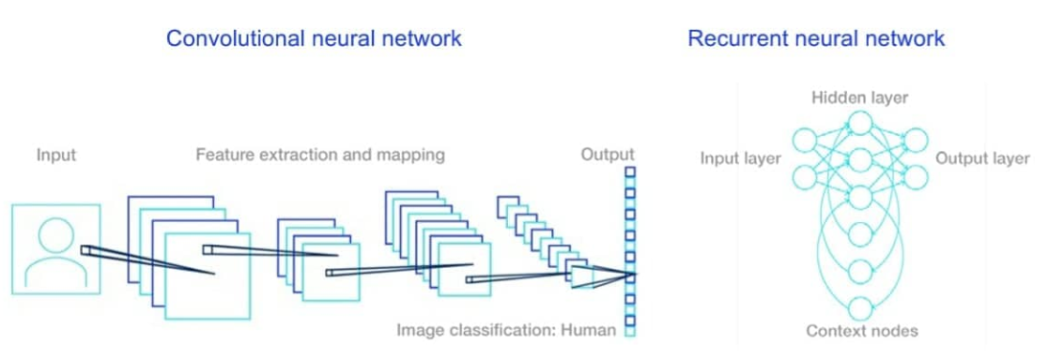
62
Notes:
62

Slide 63
Convolutional neural network
What is it
A multilayered neural network with a special architecture designed to extract increasingly complex features of the data at each layer to determine the output
63
Notes:
63

Slide 64
Convolutional neural network
When to use it
A multilayered neural network with a special architecture designed to extract increasingly complex features of the data at each layer to determine the output
64
Notes:
64

Slide 65
Convolutional neural network
How it works
Processing image
1. The convolutional neural network (CNN) receives an image—for example, of the letter “A”—that it processes as a collection of pixels
2. In the hidden, inner layers of the model, it identifies unique features, for example, the individual lines that make up “A”
3. The CNN can now classify a different image as the letter “A” if it finds in it the unique features previously identified as making up the letter
65
Notes:
65

Slide 66
Convolutional neural network
Business use case
Diagnose health diseases from medical scans
Detect a company logo in social media to better understand joint marketing opportunities (eg, pairing of brands in one product)
Understand customer brand perception and usage through images
Detect defective products on a production line through images
66
Notes:
66

Slide 67
Recurrent neural network
What is it
A multilayered neural network that can store information in context nodes, allowing it to learn data sequences and output a number or another sequence
67
Notes:
67

Slide 68
Recurrent neural network
When to use it
When you are working with time-series data or sequences (eg, audio recordings or text)
68
Notes:
68

Slide 69
Recurrent neural network
How it works
Processing image
1. A recurrent neural network (RNN) neuron receives a command that indicates the start of a sentence
2. The neuron receives the word “Are” and then outputs a vector of numbers that feeds back into the neuron to help it “remember” that it received “Are” (and that it received it first). The same process occurs when it receives “you” and “free,”with the state of the neuron updating upon receiving each word
69
Notes:
69

Slide 70
Recurrent neural network
How it works
Processing image
3. After receiving “free,” the neuron assigns a probability to every word in the English vocabulary that could complete the sentence. If trained well, the RNN will assign the word “tomorrow” one of the highest probabilities and will choose it to complete the sentence
70
Notes:
70

Slide 71
Recurrent neural network
Business case use
Generate analyst reports for securities traders
Provide language translation
Track visual changes to an area after a disaster to assess potential damage claims (in conjunction with CNNs)
Assess the likelihood that a credit-card transaction is fraudulent
Generate captions for images
Power chatbots that can address more nuanced customer needs and inquiries
71
Notes:
71

